Slide 1

Introduction to Shiny
Antonio Mora
Bioinformatics Lab Workshop, 30/08/2019

Slide 2

Summary
Summary of the previous workshops
What is Shiny
Structure of a Shiny App
Building a Shiny App
Sharing a Shiny App

Slide 3
1. Summary of the previous workshop

Slide 4
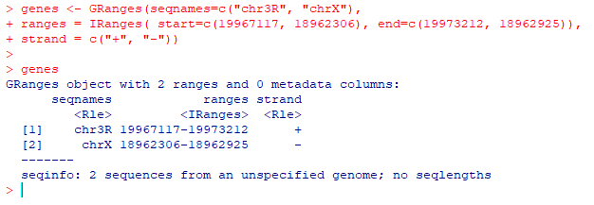
First Bioconductor Workshop
Biostrings contains tools for working with sequences (strings).
BSgenome is a collection of packages (BS.Hsapiens.UCSC.hg38, BS.Dmelanogaster.UCSC.dm3, and so on), which contain whole-genome sequences.
IRanges is the basic package to store range data. GenomicRanges is IRanges for genomics.

Slide 5
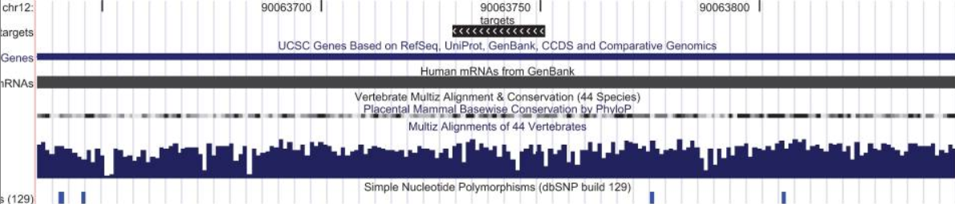
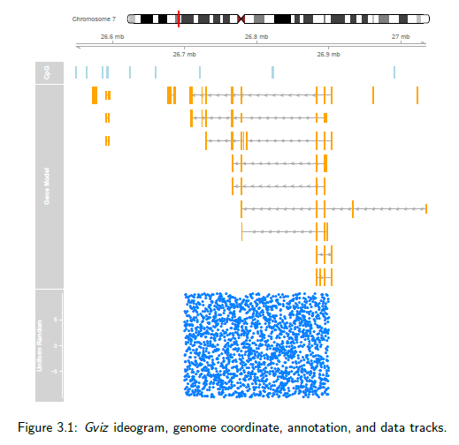
Second Bioconductor Workshop
Annotation packages in Bioconductor are based on “AnnotationDbi” (AnnotationDb objects).
OrgDb objects, ChipDb objects, TxDb objects, Go.db objects, etc.
While AnnotationDbi consists of database packages, AnnotationHub is a server to provide R access to several databases.
rtracklayer is an interface between R and genome browsers (specifically, the UCSC genome browser).
GViz is a visualization tool.

Slide 6
2. What is Shiny?

Slide 7

What is Shiny
Shiny is an R package to build interactive web applications from R, without any HTML, CSS, or JavaScript knowledge.
Packages written with Shiny are called apps.
Many examples can be found here: https://shiny.rstudio.com/gallery/
https://www.showmeshiny.com/
Also, 11 built-in examples.
Shiny is built by RStudio and can be found at CRAN.

Slide 8

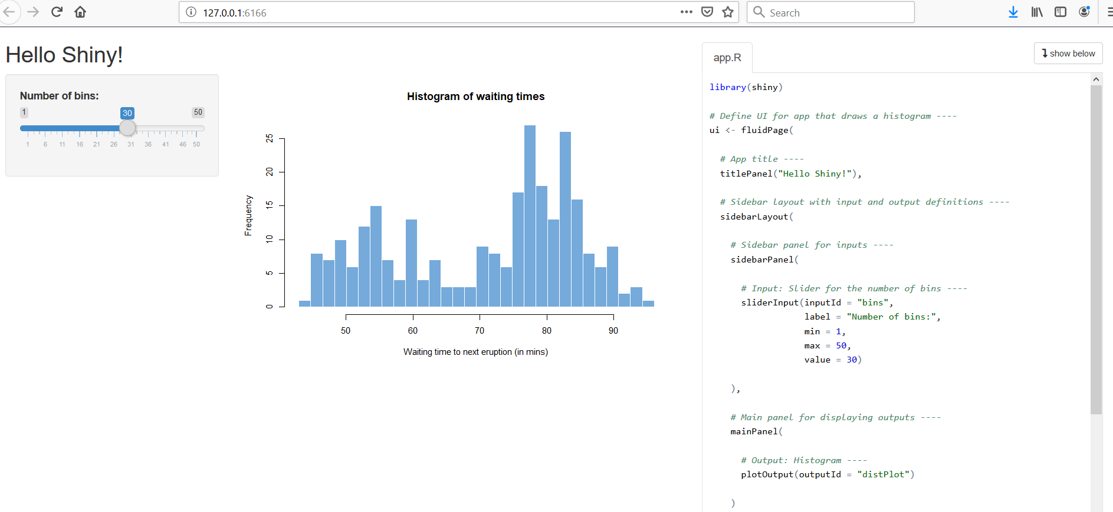
Shiny Example

Slide 9
3. Structure of a Shiny App

Slide 10
The Structure
Step 1. Build a file called “app.R” and place it in your chosen directory.
The app will be run using the name of the directory where “app.R” is located. For example: runApp("newdir").
Step 2. “app.R” has three components:
* UI: The user interface object, which controls the layout and appearance of the app.
* The server function, which contains the instructions to build your app.
* The shinyApp function, which creates a Shiny app object from the given UI/server pair.

Slide 11
4. Building a Shiny App

Slide 12
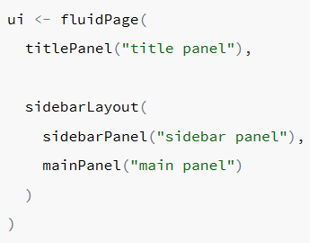
fluidPage function
Widgets (sliders, boxes, plots, etc) inside the panels:
sidebarPanel : sliderInput, …
mainPanel : plotOutput, …
Others: Select box, numeric input, text input…

Slide 13
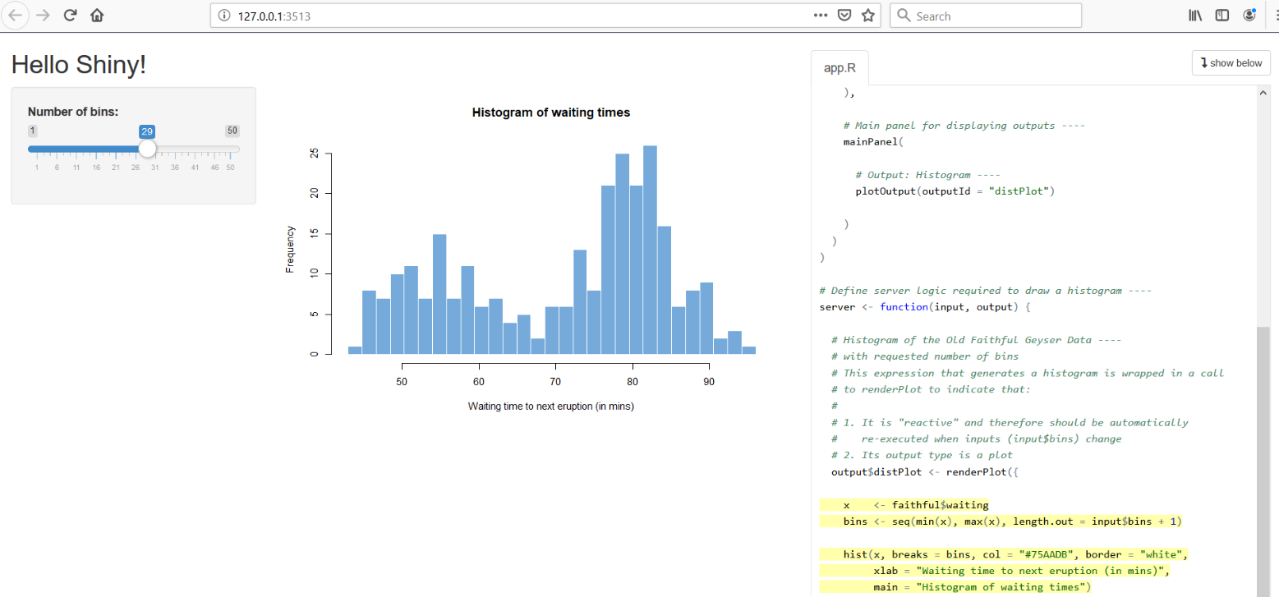
server function
“server” is a function that connects the output list to the input list:
Server <- function(input, output) {
output$* <- function(input$*)
}

Slide 14
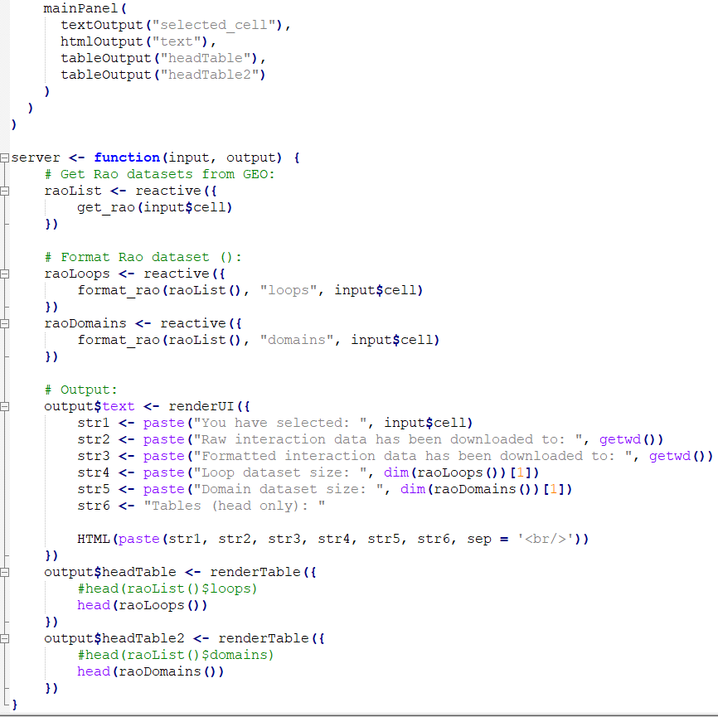
reactive function
These functions will be executed only once
These functions will be executed every time you change the input

Slide 15
5. Sharing a Shiny App

Slide 16
Two ways of sharing a Shiny app
From R:
a)
library(shiny)
runUrl( "<the weblink>")
b)
runGitHub("antonio-mora", "chrombrowseR")
From a website:
shinyapps.io: A free website.
Shiny Server: A free software to install in our server.
RStudio Connect: An advanced paid software.

Slide 17
Now let’s go to the exercises...
https://nbviewer.jupyter.org/github/antonio-mora/teacheR/blob/master/Shiny2019.ipynb
References:
https://shiny.rstudio.com/tutorial/#written-tutorials
https://bioinformatics-core-shared-training.github.io/shiny-bioinformatics/

